Slide 1
Tower Hamlets Annual Resident Survey 2024
Summary briefing

Slide 2
Introduction
Tower Hamlets Annual Residents’ Survey 2024 results
Tower Hamlets Council have run an Annual Residents’ Survey since the 1990s, other than during the pandemic.
This 2024 edition is the second since resuming after coronavirus pandemic lockdowns.
Fieldwork took place in April and May 2024.
Due to the restrictions imposed by lockdowns, the 2023 edition was the first Annual Residents’ Survey since 2019 with a comparable, face-to-face, methodology.
A telephone survey took place in 2021, but the different methodology means the surveys are not comparable.
Notes:
Questions at the end please.

Slide 3
Content
Tower Hamlets Annual Residents’ Survey 2024 results
The survey covers four broad areas and this document mirrors those with
Residents' views of the council
Residents' views of services
Residents’ views of the borough as a place to live
Residents’ personal situation and personal concerns.
There are additional sections on
Analysis
Methodology
Who we spoke to (sample profile)

Slide 4
About surveys and sampling
Tower Hamlets Annual Residents’ Survey 2024 results
All surveys, even the census, are estimates. They are also snapshots at that time, and things can change.
The ARS uses sampling. Surveys using sampling are estimates of the results that we would get if we asked the same questions to every Tower Hamlets resident.
The concept of statistical reliability is based on how confident we are that the sample of individuals we interviewed is representative of the general population.
Statistical significance and interpretation of survey data. All figures presented in the ARS are estimates, not precise measures. As such, they have a degree of sampling variability attached to them. The concept of ‘statistical significance’ is used here to highlight those differences that are likely to reflect real differences (or changes over time), as opposed to those which may be simply reflecting the sampling variability which comes with estimates.

Slide 5
How the findings are presented
Tower Hamlets Annual Residents’ Survey 2024 results
For simplicity, results throughout this document are presented as summary figures. More detail will be available in subsequent publications.
For example, the question ‘Overall, how satisfied or dissatisfied are you with the way Tower Hamlets runs things?’ is presented as Summary: Satisfied 61%. The figure of 61% combines the 4% who are ‘very satisfied’ with the 57% who are ‘fairly satisfied’.
The full results in response to that question are
Very satisfied 4%
Fairly satisfied 57%
Neither satisfied nor dissatisfied 22%
Fairly dissatisfied 13%
Very dissatisfied 3%
Don't know 1%
Figures may not sum due to rounding e.g. satisfaction with Waste services was 63.4% in 2023, and 68.5% in 2024, a difference of 5. it appears to be 6 due to rounding 68.5% up to 69%.

Slide 6
Summary
Tower Hamlets Annual Residents’ Survey 2024 results
The results of the Tower Hamlets Annual Resident Survey (ARS) 2024 were positive for the council.
Almost all perception ratings saw statistically significant increases compared to 2023.
This improvement in perception has occurred alongside a reduction in the proportion of residents answering ‘Don’t Know’ to certain questions.
In 2023, for example, 20% of residents answered Don’t Know when asked to agree or disagree with the statement ‘My council is doing a better job now than one year ago. The Don’t Know figure for 2024 was 8%, higher than 2019 (5%) but lower than 2016 (14%), 2017 (12%), and 2018 (11%).
Residents continue to view Tower Hamlets as a place to live in a positive light: 84% are satisfied with the borough as a place to live, 90% believe people of different backgrounds get on well together.

Slide 7
Findings – benchmarking against LGA
Tower Hamlets Annual Residents’ Survey 2024 results
Topic area | Measure | Tower Hamlets | LGA
Overall, how satisfied or dissatisfied are you with your local area as a place to live? | Very or fairly satisfied | 84% | 74%
How much do you trust Tower Hamlets Council? | Great deal/Fair amount | 66% | 55%
Overall, how satisfied or dissatisfied are you with the way Tower Hamlets runs things? | Very or fairly satisfied | 61% | 53%
Overall, how well informed do you think Tower Hamlets Council keeps residents about the services and benefits it provides? | A great deal/To some extent | 65% | 54%
How safe or unsafe do you feel when outside in your local area after dark? | Safe | 67% | 70%
How safe or unsafe do you feel when outside in your local area during the day? | Safe | 95% | 92%
To what extent do you agree or disagree that this local area is a place where people from different backgrounds get on well together? | Agree | 90% | 77%*
To what extent do you agree or disagree that Tower Hamlets Council provides value for money? | Strongly or tend to agree | 51% | 40%
To what extent do you think Tower Hamlets Council acts on the concerns of local residents? | A great deal / A fair amount | 59% | 49%
Tower Hamlets performs above or at the national average for all but one key benchmarks. The LGA runs a quarterly survey of the whole country. The LGA figures are taken from the February 2024 edition other than ‘people from different backgrounds get on well together’ which was most recently reported in February 2023.

Slide 8
Findings - change over time
Tower Hamlets Annual Residents’ Survey 2024 results
To what extent do you think these statements apply to your Borough? | Measure | 2023 | 2024 | 2023-2024 | Statistically Significant?
To what extent do you agree or disagree that this local area is a place where people from different backgrounds get on well together? | Agree | 87% | 90% | 3 | Yes
Thinking about your local area/neighbourhood, how satisfied are you with the area as a place to live? | Satisfied | 78% | 84% | 6 | Yes
How safe or unsafe do you feel when outside in your local area after dark? | Safe | 66% | 67% | 1 | No
How safe or unsafe do you feel when outside in your local area during the day? | Safe | 94% | 95% | 1 | No
The benchmarked areas set out above show significant improvements in residents’ perceptions of the borough in the two most recent editions (2023 and 2024).
Residents in Tower Hamlets believe the borough is a place where people from different backgrounds get on well together, up 3 percentage points from the 2023 edition of the ARS.
Residents are more satisfied with their local area as a place to live compared to 2023, up by 6 percentage points.
Residents feel as safe as they did in 2023 with neither after dark or during the day measure seeing any statistically significant change.

Slide 9
Anti-social behaviour over time
Tower Hamlets Annual Residents’ Survey 2024 results
Thinking about this local area (within 15/20 minutes walking distance), how much of a problem do you think are…? | Measure | 2023 | 2024 | 2023-2024 | Statistically Significant?
Noisy neighbours or loud parties | Problem | 18% | 22% | 4 | Yes
People being drunk or rowdy in public places | Problem | 29% | 30% | 1 | No
Vandalism, graffiti and other deliberate damage to property or vehicles | Problem | 29% | 36% | 7 | Yes
People using or dealing drugs | Problem | 49% | 58% | 9 | Yes
Perceptions of crime and anti-social behaviour have increased in three of the four measures, reversing some of the improvements seen from 2019 to 2023, but remaining lower than the equivalent levels in 2019.

Slide 10
Views of the council
Tower Hamlets Annual Residents’ Survey 2024 results
The survey covers four broad areas
Residents' views of the council
Residents' views of services
Residents’ views of the borough as a place to live
Residents’ personal situation and personal. c
There are additional sections on
Analysis
Methodology
Who we spoke to (sample profile)oncerns

Slide 11
Residents views of the council 2024
Tower Hamlets Annual Residents’ Survey
2024 results
Resident perception | Measure | 2023 | 2024 | 2023 – 2024 | Statistically Significant?
My council involves residents when making decisions | Summary: Agree | 42% | 49% | 8 | Yes
Overall, how well informed do you think Tower Hamlets Council keeps residents about the services and benefits it provides? | Very well informed / Fairly well informed | 57% | 65% | 8 | Yes
My council is doing a good job | Summary: Agree | 56% | 58% | 2 | No
My council is efficient and well run | Summary: Agree | 53% | 54% | 1 | No
To what extent do you think Tower Hamlets Council acts on the concerns of local residents? | Summary: A great deal / A fair amount | 48% | 59% | 11 | Yes
My council responds quickly when asked for help | Summary: Agree | 40% | 49% | 9 | Yes
My council has staff who are friendly and polite | Summary: Agree | 59% | 64% | 5 | Yes
My council doesn't do enough for people like me | Summary: Agree | 42% | 46% | 4 | No
To what extent do you agree or disagree that Tower Hamlets Council provides value for money? | Summary: Agree | 45% | 51% | 6 | Yes
My council is doing a better job now than one year ago | Summary: Agree | 38% | 47% | 9 | Yes
My council is making the local area a better place for people to live | Summary: Agree | 56% | 61% | 5 | Yes
To what extent do you agree or disagree that Tower Hamlets Council is open and transparent about its activities? | Summary: Agree | 45% | 53% | 8 | Yes
How much do you trust Tower Hamlets Council? | Summary: A great deal / A fair amount | 65% | 66% | 1 | No
Overall, how satisfied or dissatisfied are you with the way Tower Hamlets runs things? | Summary: Satisfied | 63% | 61% | -2% | No
Almost all (9) of these measures have resulted in a statistically significant improvement on the 2023 results. The rise in Don’t Know responses seen in 2023 has been largely reversed. The 20% Don’t Know figure for the question on whether ‘My council is doing a better job now than one year ago’ fell to 8% in 2024.

Slide 12
Services
Tower Hamlets Annual Residents’ Survey 2024 results
The survey covers four broad areas
Residents' views of the council
Residents' views of services
Residents’ views of the borough as a place to live
Residents’ personal situation and personal. c
There are additional sections on
Analysis
Methodology
Who we spoke to (sample profile) concerns

Slide 13
Service use
Tower Hamlets Annual Residents’ Survey 2024 results
Which of these services provided locally do you or members of your household use nowadays? | 2023 | 2024 | 2023-2024 | Statistically Significant?
Parks and green spaces | 74% | 80% | 6 | Yes
Recycling Services | 76% | 65% | -12 | Yes
Libraries/idea stores | 35% | 26% | -9 | Yes
Parking services | 32% | 29% | -3 | No
Leisure and sports facilities | 35% | 20% | -15 | Yes
Housing benefit service | 24% | 24% | 0 | No
Primary Education (5-11's) provided by Tower Hamlets Council | 15% | 19% | 4 | Yes
Secondary Education (11-18's) provided by Tower Hamlets Council | 14% | 18% | 4 | Yes
Nursery education (under 5's) provided by Tower Hamlets Council | 6% | 8% | 2 | No
Children's centres | 5% | 5% | 0 | No
Services for people with disabilities | 3% | 3% | 0 | No
Adult Social Care | 4% | 2% | -2 | Yes
Adult education/ evening classes provided by Tower Hamlets Council | 4% | 5% | 1 | No
Social services for vulnerable children and families | 2% | 1% | -1 | Yes
Services and support for older people |  | 2% | n/a | n/a
Local health services |  | 68% | n/a | n/a
Social housing |  | 12% | n/a | n/a
Council housing |  | 17% | n/a | n/a
Youth services | 2% | 4% | 2 | Yes
Pest control | 4% | 6% | 2 | No
None of these | 2% | 0% | -2 | Yes
Service use is broadly unchanged. Fewer residents report using leisure and sports facilities, recycling services, Idea Stores, and social care. It may be too soon for the insourcing of leisure to impact use. More residents report using parks and open spaces.

Slide 14
All residents’ views of services in 2024
Tower Hamlets Annual Residents’ Survey 2024 results
This table presents the views of all residents. A later slide presents the views of service-users only.
How satisfied or dissatisfied you are overall with...? | Satisfied | Neither satisfied nor dissatisfied | Dissatisfied | Don't know
Waste collection | 69% | 13% | 18% | 0%
Street cleaning | 63% | 14% | 23% | 0%
Street lighting | 79% | 10% | 12% | 0%
Road maintenance | 67% | 15% | 17% | 1%
Pavement maintenance | 64% | 17% | 18% | 1%
Parks and green spaces | 81% | 10% | 7% | 2%
Sport and leisure services | 50% | 13% | 10% | 26%
Idea Stores/libraries | 57% | 13% | 5% | 24%
Council Housing | 36% | 19% | 7% | 38%
Social Housing | 36% | 20% | 7% | 37%
Recycling services | 73% | 11% | 14% | 2%
Policing | 52% | 19% | 25% | 4%
My Council Tax account | 69% | 17% | 7% | 7%
Parking services | 47% | 15% | 19% | 20%
Local health services | 62% | 17% | 16% | 5%
Housing benefit service | 42% | 17% | 4% | 36%
Pest control | 46% | 15% | 11% | 29%
Services and support for older people | 35% | 16% | 7% | 42%

Slide 15
All residents’ views of services in 2024 (continued)
Tower Hamlets Annual Residents’ Survey 2024 results
This table presents the views of all residents. A later slide presents the views of service-users only.
How satisfied or dissatisfied you are overall with...? | Satisfied | Neither satisfied nor dissatisfied | Dissatisfied | Don't know
Children's centres | 32% | 18% | 3% | 47%
Nursery education (under 5's) | 34% | 17% | 2% | 47%
Primary education (5 - 11 yrs) | 36% | 18% | 2% | 44%
Secondary education (11 - 18 yrs) | 36% | 17% | 3% | 44%
General Services and support for children and young people | 32% | 18% | 7% | 44%
Youth Services | 31% | 16% | 9% | 44%

Slide 16
Residents views of services 2023 to 2024
Tower Hamlets Annual Residents’ Survey 2024 results
How satisfied or dissatisfied you are overall with...? | 2023 | 2024 | 2023-2024 | Statistically Significant?
Waste collection | 63% | 69% | 5 | Yes
Street cleaning | 54% | 63% | 9 | Yes
Street lighting | 69% | 79% | 10 | Yes
Parks and green spaces | 67% | 81% | 14 | Yes
Sport and leisure services | 47% | 50% | 3 | No
Idea Stores/libraries | 54% | 57% | 3 | No
Council Housing | 27% | 36% | 9 | Yes
Social Housing | 26% | 36% | 10 | Yes
Recycling services | 62% | 73% | 11 | Yes
Policing | 36% | 52% | 16 | Yes
My Council Tax account | 48% | 69% | 21 | Yes
Parking services | 35% | 47% | 12 | Yes
Local health services | 50% | 62% | 12 | Yes
Housing benefit service | 55% | 42% | -13 | Yes
Pest control | 59% | 46% | -13 | Yes
Almost all services have seen improvements in residents’ views of them. Only housing benefits and pest control have seen deterioration. Note: this slide relates to all residents, not users.

Slide 17
Users views of services in 2024
Tower Hamlets Annual Residents’ Survey 2024 results
How satisfied or dissatisfied you are overall with...? | Satisfied | Neither satisfied nor dissatisfied | Dissatisfied | Don't know
Waste collection | 69% | 11% | 19% | 0%
Parks and green spaces | 85% | 9% | 6% | 0%
Sport and leisure services | 79% | 7% | 9% | 5%
Idea Stores/libraries | 81% | 10% | 4% | 5%
Council Housing | 71% | 12% | 11% | 6%
Social Housing | 42% | 23% | 20% | 15%
Recycling services | 70% | 14% | 15% | 1%
Parking services | 55% | 14% | 30% | 2%
Local health services | 64% | 17% | 18% | 1%
Housing benefit service | 81% | 11% | 6% | 2%
Pest control | 63% | 7% | 27% | 3%
Services and support for older people | 29% | 41% | 24% | 6%
Children's centres | 75% | 16% | 2% | 7%
Nursery education | 79% | 9% | 5% | 8%
Primary education | 82% | 7% | 6% | 4%
Secondary education | 76% | 10% | 9% | 4%
Youth services | 44% | 8% | 20% | 28%

Slide 18
Users views of services from 2023 to 2024
Tower Hamlets Annual Residents’ Survey 2024 results
How satisfied or dissatisfied you are overall with...? | 2023 Satisfied | 2024 Satisfied | 2023-2024 | Statistically significant?
Parks and green spaces | 73% | 85% | 12 | Yes
Sport and leisure services | 67% | 79% | 12 | Yes
Idea Stores/libraries | 78% | 81% | 4 | No
Recycling services | 65% | 70% | 5 | Yes
Parking services | 52% | 55% | 3 | No
Housing benefit service | 55% | 81% | 26 | Yes
Pest control | 59% | 63% | 4 | No
Children's centres | 69% | 75% | 6 | No
Nursery education | 73% | 79% | 6 | No
Primary education | 79% | 82% | 4 | No
Secondary education | 70% | 76% | 6 | No
Youth services | 47% | 44% | -3 | No
Parks, sports, and housing benefit saw increases among users. The views of residents who report they are users of the housing benefit service improved by 26 points. Note: The apparent discrepancy in Idea Stores/libraries is due to rounding. Also note: as these are only the views of the users of each service the sample sizes are much smaller.

Slide 19
A place to live
Tower Hamlets Annual Residents’ Survey 2024 results
The survey covers four broad areas
Residents' views of the council
Residents' views of services
Residents’ views of the borough as a place to live
Residents’ personal situation and personal concerns. c
There are additional sections on
Analysis
Methodology
Who we spoke to (sample profile)

Slide 20
Crime and anti-social behaviour
Tower Hamlets Annual Residents’ Survey 2024 results
Thinking about this local area (within 15/20 minutes walking distance), how much of a problem do you think are…? Summary: A very big problem / A fairly big problem | 2023 | 2024 | 2023-2024 | Significant?
Noisy neighbours or loud parties | 18% | 22% | 4 | Yes
People being drunk or rowdy in public places | 29% | 30% | 1 | No
Vandalism, graffiti and other deliberate damage to property or vehicles | 29% | 36% | 7 | Yes
People using or dealing drugs | 49% | 58% | 9 | Yes
How safe or unsafe do you feel when outside in your local area .. Summary: Very safe and fairly safe | 2023 | 2024 | 2023-2024 | Significant?
After Dark? | 66% | 67% | 0 | No
During the day? | 94% | 95% | 1 | No
How much would you agree or disagree that the police and other local public services are successfully dealing with crime and anti-social behaviour in your local area? | 2023 | 2024 | 2023-2024 | Significant?
Agree | 47% | 48% | 1 | No
Across all these measures the picture is mixed. These findings indicate residents feel as safe as they did in 2023, that their perception of some kinds of anti-social behaviour has risen, but their view of how well crime is being dealt with is unchanged.

Slide 21
Social cohesion
Tower Hamlets Annual Residents’ Survey 2024 results
To what extent do you agree or disagree that this local area is a place where people from different backgrounds get on well together? | 2023 | 2024 | 2023-2024 | Significant?
Summary Agree | 87% | 90% | 3 | Yes
Thinking about your local area/neighbourhood, how satisfied are you with the area as a place to live? | 2023 | 2024 | 2023-2024 | Significant?
Summary Satisfied | 78% | 84% | 6 | Yes
Residents’ perception of social cohesion continues to improve. There have been slight increases in the percentage of residents who report that their local area is one where people get on well together. Residents are also more likely to report that they are satisfied with their area as a place to live.

Slide 22
Personal situation
Tower Hamlets Annual Residents’ Survey 2024 results
The survey covers four broad areas
Residents' views of the council
Residents' views of services
Residents’ views of the borough as a place to live
Residents’ personal situation and personal concerns. c
There are additional sections on
Analysis
Methodology
Who we spoke to (sample profile)

Slide 23
Residents' personal concerns in 2024
Tower Hamlets Annual Residents’ Survey 2024 results
Crime and the cost of living remain the top concerns by a distance.
Crime returns to top place in 2024 (42%). Otherwise, the cost of living remains a dominant concern as three of the top five concerns relate to that with
Rising prices and interest rates (40%),
Level of council tax (26%),
Lack of affordable housing (22%).
Concerns about health services follows on 21%.
Which three of these are you PERSONALLY most concerned about? | Total
Crime and anti-social behaviour | 42%
Rising prices and interest rates | 40%
Level of council tax | 26%
Lack of affordable housing | 22%
Quality of health services | 21%
Street cleanliness | 18%
Quality of housing | 15%
Homelessness | 15%
Availability of employment | 12%
Traffic congestion | 11%
Other | 8%
Level of air pollution | 7%
Availability of recreational facilities | 5%
Services for older people | 5%
Overcrowded homes | 5%
The environment or climate | 5%
Standard of education | 4%
Quality of public transport | 4%
None of these | 4%
Don't know | 1%

Slide 24
Personal concerns change
Tower Hamlets Annual Residents’ Survey 2024 results
Which three of these are you personally most concerned about? | 2023 | 2024 | 2023-2024 | Significant?
Crime and anti-social behaviour | 39% | 42% | 3 | No
Rising prices/interest rates | 40% | 40% | 0 | No
Level of council tax | 24% | 26% | 2 | No
Lack of affordable housing | x | 22% | x | n/a
Quality of health service | 23% | 21% | -2 | No
Street cleanliness | 30% | 18% | -13 | Yes
Quality of Housing | 18% | 15% | -3 | Yes
Homelessness | 17% | 15% | -2 | No
Quality of housing | 18% | 15% | -3 | Yes
Availability of employment | 9% | 12% | 4 | Yes
Traffic congestion | 12% | 11% | -2 | No
Other | 7% | 8% | 2 | No
Level of air pollution | 11% | 7% | -4 | Yes
Services for older people | 7% | 5% | -2 | Yes
The environment or climate | 5% | 5% | 0 | No
Availability of recreational facilities | 7% | 5% | -2 | Yes
Overcrowded homes | x | 5% | x | n/a
Standards of education | 5% | 4% | -1 | No
Quality of public transport | 3% | 4% | 1 | No
None of these | 5% | 4% | -1 | No
Don't know | 1% | 1% | 0 | No
Few personal concerns saw statistically significant changes from 2023 to 2024. Of those with meaningful change, only Availability of Employment increased (3 points). Street cleanliness saw the biggest fall at 12 points.

Slide 25
Findings: Personal concerns – cost of living
Tower Hamlets Annual Residents’ Survey 2024 results
Residents remain concerned about the cost of living. In 2024, as in 2023, 40% of residents listed rising prices / interest rates in their top 3 concerns. As the figure remains at 40%, it continues to be 22 percentage points above the level in 2019 and double its previous highest level (21% in 2013).

Slide 26
Personal finances
Tower Hamlets Annual Residents’ Survey 2024 results
Taking everything together, which of these phrases best describes how you and your household manage financially these days? | 2023 | 2024 | 2023-2024 | Significant?
Manages very well | 10% | 5% | -6 | Yes
Manages quite well | 36% | 32% | -3 | No
Get by alright | 36% | 48% | 12 | Yes
Don’t manage very well | 8% | 7% | -1 | No
Have some financial difficulties | 5% | 4% | -1 | No
Are in some deep financial trouble | 1% | 0% | -1 | Yes
Don’t know | 1% | 1% | 0 | No
Prefer not to say | 3% | 3% | 0 | No
Manage well | 82% | 85% | 3 | No
Manage poorly | 14% | 11% | -3 | Yes
Net: Well | 68% | 74% | 6 | Yes
There has been a slight (statistically significant) improvement in the self-reported financial position of residents of the borough. The findings imply the deterioration in 2023 has been reversed and is now back to being in line with 2019 levels.

Slide 27
Costs residents are concerned about
Tower Hamlets Annual Residents’ Survey 2024 results
Thinking about your finances, which, if any, of the following are you most concerned about at the moment | 2023 | 2024 | 2023-2024 | Significant
Paying other bills or costs | 30% | 31% | 2 | No
Paying the rent / mortgage | 29% | 29% | 0 | No
Paying council tax | 27% | 28% | 1 | No
Paying utility bills (eg gas, electricity) | 50% | 38% | -12 | Yes
Paying for food / grocery bills | 32% | 30% | -2 | No
Paying credit card bills | 8% | 10% | 2 | No
Paying loans | 4% | 5% | 2 | No
I am not concerned about any of these issues | 32% | 38% | 6 | Yes
Prefer not to say | 6% | 4% | -2 | Yes
Don’t know | 2% | 2% | 1 | No
There are reasons to be cautiously optimistic that residents’ financial positions are improving. The proportion of residents concerned about paying utility bills is down 12 points, and those saying they are not concerned about any of these is up 6. While the position remains concerning by historical standards, these findings imply things may be improving.

Slide 28
Analysis
Tower Hamlets Annual Residents’ Survey 2024 results
The survey covers four broad areas
Residents' views of the council
Residents' views of services
Residents’ views of the borough as a place to live
Residents’ personal situation and personal concerns. c
Additional sections
Analysis
Methodology
Who we spoke to (sample profile)

Slide 29
Analysis - summary
Tower Hamlets Annual Residents’ Survey 2024 results
Many key indicators continue to improve compared to 2023.
The council (as in 2023) is performing well against national benchmarked data.
Residents continue to be concerned about the cost of living, but there are signs the greatest challenges may be beginning to recede.
In 2024, residents reporting financial difficulties are more likely to report dissatisfaction with how the council runs things overall (24% dissatisfied compared to 16% for all residents).
The percentage of residents reporting that they were not concerned about paying bills etc. rose from 32% in 2023 to 38% in 2024. These figures demonstrate the apparent correlation between how well-off residents feel and their perception of the council: as one rises so does the other.

Slide 30
Context
Tower Hamlets Annual Residents’ Survey 2024 results
The external context within which the Annual Residents Survey took place was unusually tumultuous in 2023 and 2024.
The ARS 2024 fieldwork was undertaken around the time of the 2024 London mayoral and Assembly elections, the 2024 United Kingdom general election, and the ongoing Israel–Hamas war in Gaza.
The London mayoral, London assembly, and UK general elections are likely to have increased the salience of the questions in the survey.
It is possible the lower level of Don’t Know responses compared to 2023 is due to residents’ greater engagement with political questions due to the effects of the election campaigns.
In addition to the elections, several stories have featured in the press which may impact residents' views, perhaps raising the salience of the council and the borough, making residents think about things they might not otherwise.
The context includes: a London MP talking of "no-go" areas and press reporting of ‘a sense of alienation and broken trust’ in Tower Hamlets.
The cost of living situation remains challenging. Tower Hamlets residents are highly exposed to increased rents.
Public perception of public services has declined significantly, with 3 in 5 Britons believing public services have worsened in the last five years. And more than 8 in 10 blame councils for services getting worse.
Public trust in political institutions has fallen over recent years (since 2018), including trust in councils and councillors. Trust in politicians, and in the police are at historic lows.
Despite these challenges, residents remain positive about the area as a place to live, and the community cohesion in the borough, while trust in the council has in fact increased.

Slide 31
Analysis - demographics
Tower Hamlets Annual Residents’ Survey 2024 results
Overall satisfaction with the council shows some differences between residents.
Men are slightly more likely to be ‘very satisfied’, women slightly less so (5% versus 3%).
White residents are more likely to report being dissatisfied (20%) compared to ethnic minority residents (14%).
Asian residents are more satisfied overall (65% compared to 61%).
Residents who speak English at home are less satisfied (56%) compared to residents overall (61%). Residents who speak Bengali at home show no statistically significant difference to residents overall.
Residents aged 55+ are less likely to be satisfied than residents overall (54% compared to 61%).
There are no differences on this question by health problem/disability, being a parent, or by being a carer.
There are some differences by tenancy type – private renters are more positive (66%), mortgage-holders less so (54%) compared to 61% overall.

Slide 32
Analysis – exploring linkages
Tower Hamlets Annual Residents’ Survey 2024 results
Residents who are more positive about the council are also more positive about the police and vice versa. Though the council and the police are separate, residents’ views of one appear to influence their view of the other.
When asked whether they are satisfied with the council overall, those who believe police / local services are dealing well with crime / antisocial behaviour are more likely to be satisfied (74% compared to 61% overall).
Residents who are dissatisfied overall are also more likely to disagree that police / local services are dealing well with crime / antisocial behaviour.
These figures imply that perceptions around crime correlate with, and may drive, satisfaction with the council.

Slide 33
Methodology
Tower Hamlets Annual Residents’ Survey 2024 results
The survey covers four broad areas
Residents' views of the council
Residents' views of services
Residents’ views of the borough as a place to live
Residents’ personal situation and personal concerns. c
Additional sections
Analysis
Methodology
Who we spoke to (sample profile)

Slide 34
Methodology 1
Tower Hamlets Annual Residents’ Survey 2024 results
The 2024 Tower Hamlets Annual Residents Survey (ARS) was conducted by an external contractor called MEL Research. Analysis within this document is a combination of their work and our own.
MEL Research interviewed a stratified random sample of 1,133 residents of Tower Hamlets. So far as possible, all elements of the survey are the same as in 2023. The methodology is the same to ensure comparability.
The ARS uses stratified random sampling to make sure we ask a representative sample of residents. Stratified sampling means drawing up quotas of people with different characteristics in line with their relative size in the “population” (all residents) e.g. males, females etc.
Surveys were conducted at over 100 locations.
MEL interviewed 1,133 Tower Hamlets residents – our “sample”. With a sample of this size, at a 95% level of confidence, and on a 50% agreement score, the confidence intervals attached to the % ratings is ±3.0%. This means that there is a 95% chance that the “true” value will (if we had interviewed all residents) fall within 47% and 53%. The confidence intervals depend as well on the result itself: the closer to 50% the wider the confidence interval; the further away from 50% (i.e., closer to 0% or 100%) the narrower the confidence interval.

Slide 35
Methodology 2
Tower Hamlets Annual Residents’ Survey 2024 results
In each ward, Census Output Areas (COAs) were ranked by the Index of Multiple Deprivation (IMD). COAs were then selected at random as sampling points. The number of sampling points selected was proportional to the interviewing target for each ward. All addresses for each COA sampling point were made available to interviewers, with a target of 10 interviews set per sampling point.
For this survey, ward-level quotas were set by age and gender to ensure that the sample reflected the characteristics of the borough’s population. Quotas were set using Census 2021 data.
Quotas were set by gender, age, work status and ethnicity at the ward and local authority level to ensure a representative spread by demographic profile.
The survey included a screening question to ensure only residents who have lived in the Borough for at least 6 months were interviewed.
The contractor had interviewers who spoke languages other than English in order to reach members of the diverse communities in Tower Hamlets.
Figures throughout may not sum to 100% due to rounding.

Slide 36
Methodology 3
Tower Hamlets Annual Residents’ Survey 2024 results
In total 1,133 interviews were completed. While the application of quotas at ward level ensured a diverse mix of residents were interviewed, the final dataset was weighted. This weighting eliminated the effect of differential response rates by geography and between demographic groups so that the resulting data is fully representative of the borough. The final data was weighted by ward, age and gender, using 2021 Census population data.
The sample size of 1,133 means that this dataset has a maximum confidence level of +/-2.9 percentage points at the borough level (at a 95% level of confidence). This means that we can say with 95% confidence that the responses reported will be no more than 2.9 percentage-points different than if all residents of the borough were interviewed.
Sub-group analysis i.e., comparing responses from particular resident groups or from specific locations within the borough will have higher confidence intervals.

Slide 37
Sample profile
Tower Hamlets Annual Residents’ Survey 2024 results
The survey covers four broad areas
Residents' views of the council
Residents' views of services
Residents’ views of the borough as a place to live
Residents’ personal situation and personal concerns. c
Additional sections
Analysis
Methodology
Who we spoke to (sample profile)

Slide 38
Who we spoke to: Sample profile 1 of 2
Tower Hamlets Annual Residents’ Survey 2024 results
Age | Count | %
18 to 24 | 164 | 14%
25 to 34 | 342 | 30%
35 to 44 | 214 | 19%
45 to 54 | 185 | 16%
55 to 64 | 102 | 9%
65 to 74 | 80 | 7%
75+ | 46 | 4%
Grand Total | 1,133 | 100%
Ethnicity | Count | %
Bangladeshi | 384 | 34%
White British | 362 | 32%
Any other White background | 112 | 10%
Indian | 51 | 5%
Caribbean | 46 | 4%
African | 32 | 3%
Chinese | 19 | 2%
Any other background | 18 | 2%
Any other Asian background | 18 | 2%
Prefer not to say | 16 | 1%
Irish | 11 | 1%
Somali | 11 | 1%
Pakistani | 10 | 1%
White and Asian | 9 | 1%
White and Black Caribbean | 9 | 1%
Any other Mixed background | 8 | 1%
Arab | 5 | 0%
White and Black African | 5 | 0%
Vietnamese | 3 | 0%
Gypsy / Roma | 3 | 0%
Any other Black / African / Caribbean background | 1 | 0%
Grand Total | 1,133 | 100%
What is your religion or belief? | Count | %
Muslim | 441 | 39%
No religion or belief | 329 | 29%
Christian | 267 | 24%
Hindu | 30 | 3%
Prefer not to say | 28 | 2%
Agnostic | 15 | 1%
Buddhist | 11 | 1%
Sikh | 7 | 1%
Jewish | 2 | 0%
Prefer to self-describe | 1 | 0%
Don't know | 1 | 0%
Humanist | 1 | 0%
Grand Total | 1,133 | 100%
Sex | Count | %
Male | 570 | 50%
Female | 561 | 50%
Prefer not to say | 1 | 0%
Prefer to self-describe | 1 | 0%
Grand Total | 1,133 | 100%
What is the main language spoken in the home? | Count | %
English | 685 | 60%
Bengali (Shuddo / Shyleti / Other) | 326 | 29%
Other | 110 | 10%
Somali | 12 | 1%
Grand Total | 1,133 | 100%
Gender | Count | %
Male | 571 | 50%
Female | 561 | 50%
Other | 1 | 0%
Grand Total | 1,133 | 100%

Slide 39
Sample profile 2 of 2
Tower Hamlets Annual Residents’ Survey 2024 results
Working status | Count | %
Working full-time | 611 | 54%
Retired | 144 | 13%
Working part-time | 109 | 10%
Not working and not seeking work | 94 | 8%
Not working and seeking work | 87 | 8%
Full-time education | 71 | 6%
Prefer not to say | 17 | 2%
Grand Total | 1,133 | 100%
Grouped ward | Count | %
North | 315 | 28%
East | 273 | 24%
South | 273 | 24%
West | 272 | 24%
Grand Total | 1,133 | 100%
Housing status | Count | %
Rent from private landlord | 364 | 32%
Rent from Housing Association / Trust | 244 | 22%
Rent from Local Authority | 228 | 20%
Own home with mortgage or loan | 150 | 13%
Own home outright with no mortgage or loan | 82 | 7%
Other | 30 | 3%
Prefer not to say | 27 | 2%
Part-own and part-rent (shared ownership) | 8 | 1%
Grand Total | 1,133 | 100%
Which best describes your current marital, civil partnership or cohabitation status? | Count | %
Single (never married or never registered a civil partnership) | 523 | 46%
Married | 505 | 45%
Cohabitating with a partner | 43 | 4%
Prefer not to say | 21 | 2%
Divorced | 18 | 2%
Widowed | 17 | 2%
Separated, but still legally married | 3 | 0%
Separated, but still in a registered civil partnership | 2 | 0%
In a registered civil partnership | 1 | 0%
Grand Total | 1,133 | 100%
Do you have parenting responsibilities? | Count | %
No | 774 | 68%
Yes | 355 | 31%
Prefer not to say | 4 | 0%
Grand Total | 1,133 | 100%
Day-to-day activities limited because of a health problem or disability | Count | %
No | 1018 | 90%
Yes | 102 | 9%
Prefer not to say | 13 | 1%
Grand Total | 1,133 | 100%

Slide 40
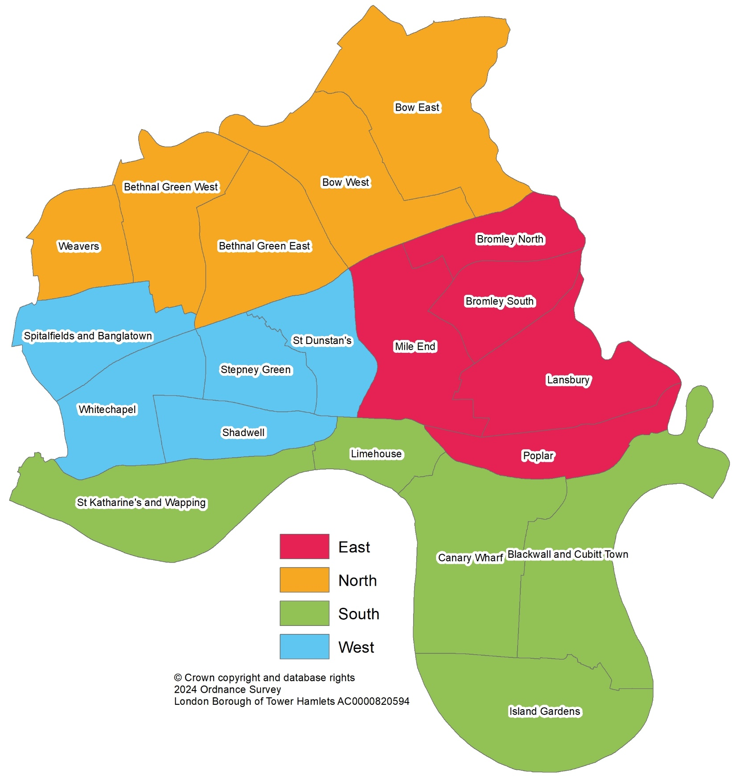
Geography – special analysis
Tower Hamlets Annual Residents’ Survey 2024 results
Ward Name | Completes | N/S/E/W
Bethnal Green East (Bethnal Green) | 76 | North
Bethnal Green West (St Peter’s) | 70 | North
Blackwall & Cubitt Town | 81 | South
Bow East | 71 | North
Bow West | 50 | North
Bromley North | 40 | East
Bromley South | 54 | East
Canary Wharf | 66 | South
Island Gardens | 55 | South
Lansbury | 83 | East
Limehouse | 25 | South
Mile End | 70 | East
Poplar | 26 | East
Shadwell | 52 | West
Spitalfields & Banglatown | 52 | West
St Dunstan's | 54 | West
St Katharine's & Wapping | 46 | South
Stepney Green | 42 | West
Weavers | 48 | North
Whitechapel | 72 | West
In order to analyse the data at more statistically robust geographies, wards have been grouped into four localities (North, South, East and West) as per the map.

Slide 41
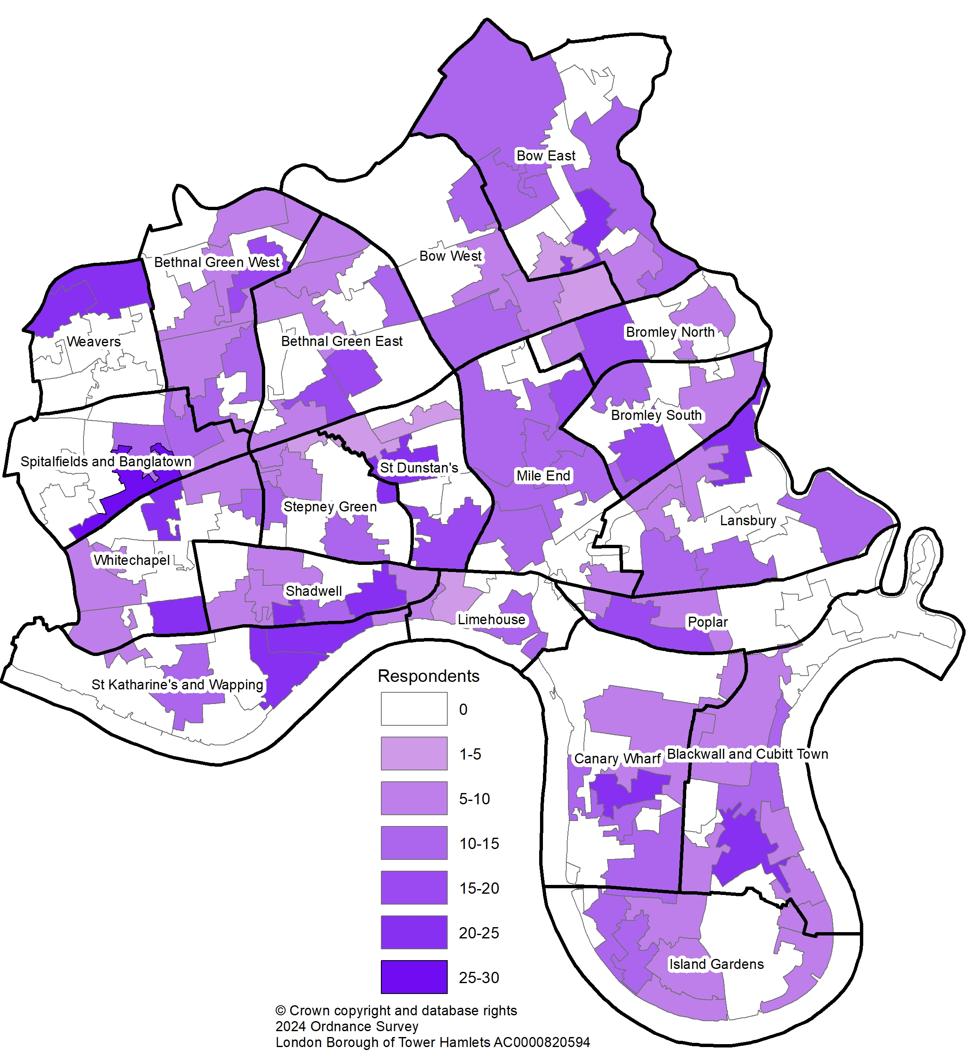
Geography – special analysis (cont)
Tower Hamlets Annual Residents’ Survey 2024 results
Ward Name | Completes | N/S/E/W
Bethnal Green East (Bethnal Green) | 76 | North
Bethnal Green West (St Peter’s) | 70 | North
Blackwall & Cubitt Town | 81 | South
Bow East | 71 | North
Bow West | 50 | North
Bromley North | 40 | East
Bromley South | 54 | East
Canary Wharf | 66 | South
Island Gardens | 55 | South
Lansbury | 83 | East
Limehouse | 25 | South
Mile End | 70 | East
Poplar | 26 | East
Shadwell | 52 | West
Spitalfields & Banglatown | 52 | West
St Dunstan's | 54 | West
St Katharine's & Wapping | 46 | South
Stepney Green | 42 | West
Weavers | 48 | North
Whitechapel | 72 | West
This shows respondents by their LSOA

